Slide 1
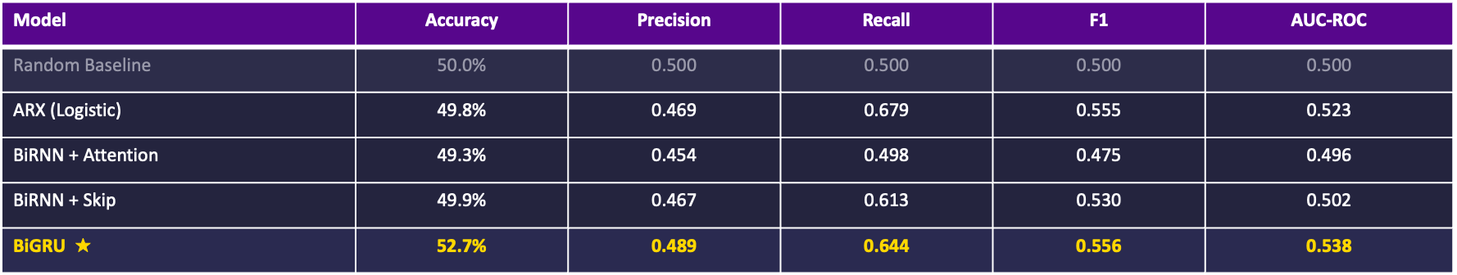
NYU
Vertically Integrated Projects | Agriculture Commodity Forecasting
Wheat Futures
Price Forecasting Classification
Nishant Pushparaju | N11677724 | April 01, 2026
VIP Agriculture — Wheat Futures Price Forecasting | NYU Tandon School of Engineering
Notes:
SPEAKER NOTES — Title Slide Good morning/afternoon everyone. I'm Nishant Pushparaju. Over the past four weeks, our team has been building and evaluating a series of models for wheat futures price forecasting. Today I'll walk through four models in sequence — starting with the classical econometric baseline ARX, then three progressively more complex deep learning approaches: Bidirectional RNN with Attention, BiRNN with Skip Connections, and Bidirectional GRU. The goal is to understand what each architectural choice contributes, and to be honest about where the models succeed and where the naive persistence baseline is genuinely hard to beat.

Slide 2
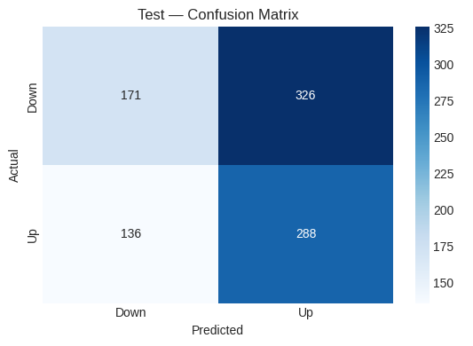
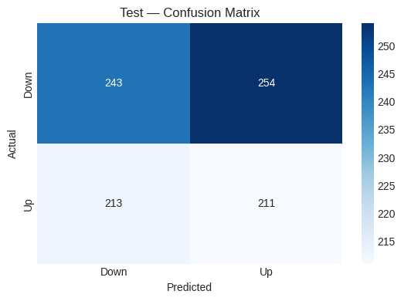
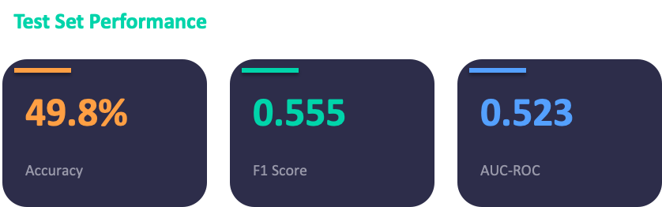
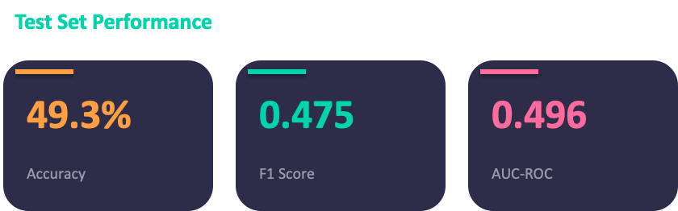
Week 1
NYU
Classification Models Comparison - 1
ARX Classifier (Logistic Regression)
Bidirectional RNN + Self-Attention
Notes:
SPEAKER NOTES — Slide 2: ARX ARX is the classical econometric baseline implemented in Week 1. It predicts tomorrow's wheat price using two components: its own past prices (the AR part, up to 3 lags) and 31 macroeconomic features from FRED-MD (the exogenous part). Fitting is done in closed form using Ridge OLS — no iterative training, no learning rate issues. Alpha=5 applies mild L2 regularisation to handle the multicollinearity across 31 correlated macro features. Grid search over ar_lags, exog_lags, and alpha found the best configuration is ar_lags=3, exog_lags=1, alpha=5. This tells us that only the most recent few days of price history matter, and only the current month's macro reading (not lagged) adds value. Test R²=0.983, essentially identical to the naive persistence baseline at 0.984. This is expected — wheat futures prices are highly autocorrelated day-to-day, and the AR-3 coefficient of 0.88 means the model is mostly saying "tomorrow ≈ today." The exogenous features add only marginal correction. The test plot (right) shows the model tracks the 2022 Ukraine war spike and the subsequent decline. The fit looks good visually, but the RMSE of 20.99 vs naive 20.37 tells us the linear model is not adding value over simple persistence. This sets the baseline. Any neural model that can't beat ARX isn't worth deploying.

Slide 3
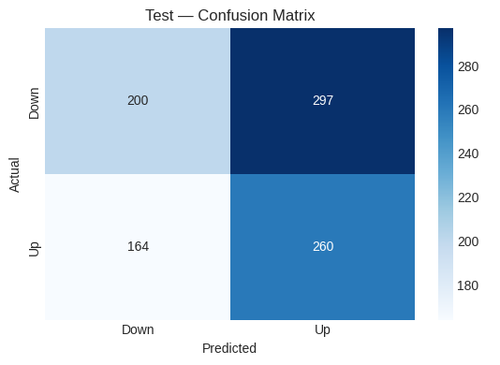
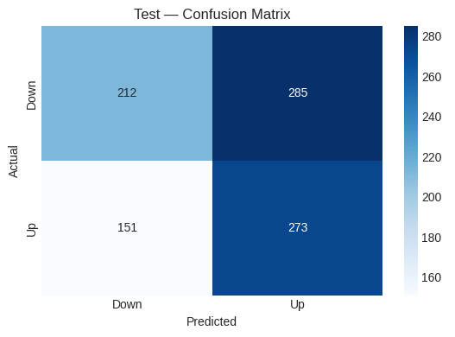
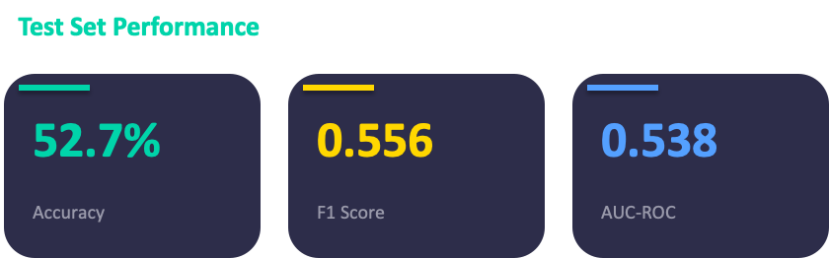
Week 1
NYU
Classification Models Comparison - 2
Bidirectional RNN + Self-Attention
Bidirectional RNN + Self-Attention
Notes:
SPEAKER NOTES — Slide 2: ARX ARX is the classical econometric baseline implemented in Week 1. It predicts tomorrow's wheat price using two components: its own past prices (the AR part, up to 3 lags) and 31 macroeconomic features from FRED-MD (the exogenous part). Fitting is done in closed form using Ridge OLS — no iterative training, no learning rate issues. Alpha=5 applies mild L2 regularisation to handle the multicollinearity across 31 correlated macro features. Grid search over ar_lags, exog_lags, and alpha found the best configuration is ar_lags=3, exog_lags=1, alpha=5. This tells us that only the most recent few days of price history matter, and only the current month's macro reading (not lagged) adds value. Test R²=0.983, essentially identical to the naive persistence baseline at 0.984. This is expected — wheat futures prices are highly autocorrelated day-to-day, and the AR-3 coefficient of 0.88 means the model is mostly saying "tomorrow ≈ today." The exogenous features add only marginal correction. The test plot (right) shows the model tracks the 2022 Ukraine war spike and the subsequent decline. The fit looks good visually, but the RMSE of 20.99 vs naive 20.37 tells us the linear model is not adding value over simple persistence. This sets the baseline. Any neural model that can't beat ARX isn't worth deploying.

Slide 4








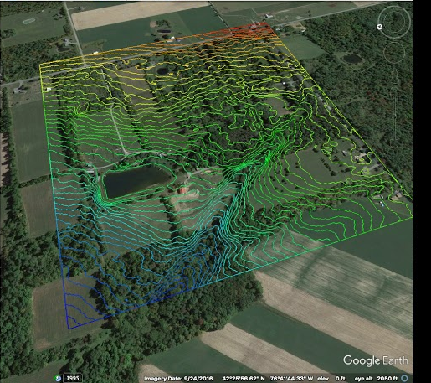


Week 1
NYU
Dataset and Implementation Proposal
Wang & Zhang (2024) Predictability of commodity futures returns with machine learning models
Manogna et al. (2025) Enhancing agricultural commodity price forecasting with deep learning
Gutierrez & Taieb (2021) Google trends as predictor of grain prices
Wang et al. (2023) Climate and Envt. Data Contribute to the Predn. of Grain Commodity Prices
Teste (2025) Forecasting Agricultural Commodity Prices from Satellite
Ghali et al. (2024) Forecasting Commodity Price Shocks Using Temporal and Semantic Fusion
Isengildina-Massa (2023) What Do We Know About the Accuracy and Impact of USDA Reports?
Notes:
SPEAKER NOTES — Slide 2: ARX ARX is the classical econometric baseline implemented in Week 1. It predicts tomorrow's wheat price using two components: its own past prices (the AR part, up to 3 lags) and 31 macroeconomic features from FRED-MD (the exogenous part). Fitting is done in closed form using Ridge OLS — no iterative training, no learning rate issues. Alpha=5 applies mild L2 regularisation to handle the multicollinearity across 31 correlated macro features. Grid search over ar_lags, exog_lags, and alpha found the best configuration is ar_lags=3, exog_lags=1, alpha=5. This tells us that only the most recent few days of price history matter, and only the current month's macro reading (not lagged) adds value. Test R²=0.983, essentially identical to the naive persistence baseline at 0.984. This is expected — wheat futures prices are highly autocorrelated day-to-day, and the AR-3 coefficient of 0.88 means the model is mostly saying "tomorrow ≈ today." The exogenous features add only marginal correction. The test plot (right) shows the model tracks the 2022 Ukraine war spike and the subsequent decline. The fit looks good visually, but the RMSE of 20.99 vs naive 20.37 tells us the linear model is not adding value over simple persistence. This sets the baseline. Any neural model that can't beat ARX isn't worth deploying.

Slide 5
Week 1
NYU
Dataset and Implementation Proposal
Data Source | Features Used | What It Provides
CFTC COT cftc.gov | Weekly | hedge_pr, spec_se, pos_chg, spec_z, oi_lev | WHO is betting on wheat — hedge fund vs farmer positioning. Extreme positions signal reversals.
Corn Futures Yahoo Finance | Daily | corn_cl, wc_rat, wc_m20, rel_cn | Feed substitution pressure — when wheat is expensive relative to corn, demand shifts to corn.
Soybean Futures Yahoo Finance | Daily | soy_cl, ws_rat, ws_m20 | Acreage competition — farmers choose between planting wheat or soybeans based on relative price.
Crude Oil (WTI) Yahoo Finance | Daily | oil_cl, rel_ol | Input cost for farming — fertilizer, transportation, and grain drying are all oil-dependent.
USD Index Yahoo Finance | Daily | usd_cl, usd_c10 | Wheat is traded globally in USD. Strong dollar makes wheat expensive for foreign buyers -> less demand.
Gold Futures Yahoo Finance | Daily | gold_cl, gld_c10 | Inflation / safe-haven proxy. Gold and commodities move together during inflation fear periods.
Google Trends trends.google.com | Weekly | wheat_price, wheat_futures, drought, crop_failure, USDA_report | Public attention — search spikes for 'drought' or 'wheat price' precede actual price moves.
Weather — Kansas Open-Meteo | Daily | temp_max, temp_min, precip, rain, snowfall, wind_speed | Growing conditions in top US wheat state. Drought/frost = supply shock -> price up.
Weather — N. Dakota Open-Meteo | Daily | temp_max, temp_min, precip, rain, snowfall, wind_speed | Second major wheat state. Spring wheat variety. Different climate risk than Kansas winter wheat.
VIX Yahoo Finance | Daily | vix_close | Market-wide fear index. VIX spikes trigger cross-asset de-risking including commodities.
OVX Yahoo Finance | Daily | ovx_close | Oil-specific volatility. High OVX = uncertainty in energy costs that feed into ag input prices.
NASA POWER power.larc.nasa.gov | Daily | nasa_t2m, nasa_prectotcorr, nasa_allsky_sfc_sw_dwn, nasa_rh2m, nasa_ws2m | Vegetation / growing condition proxy. Solar radiation and humidity directly affect crop health.
Technical Indicators Computed from OHLCV | mom_5d, mom_10d, mom_20d, rsi, macd, macd_hist, bb_pctb, atr, vol_sma | Price microstructure — momentum, overbought/oversold, trend strength, volatility regime.
Notes:
⏺ Here's the clean grouping — 8 papers, each responsible for specific datasets:
---
Paper 1: Wang & Zhang (2024), J. Futures Markets
"Predictability of Commodity Futures Returns with Machine Learning Models"
Why we chose this paper: Only study we found that directly combines COT positioning data with ML for commodity futures. Tested on 22 commodities with
rigorous out-of-sample evaluation. Sharpe 2.07 is an exceptional result.
What it told us to collect:
- CFTC Commitment of Traders (hedge fund vs commercial positioning)
Their key finding: Hedging pressure (from COT) ranked as a top feature via Shapley analysis. LightGBM outperformed all linear models.
---
Paper 2: Manogna et al. (2025), Scientific Reports
"Enhancing agricultural commodity price forecasting with deep learning"
Why we chose this paper: Largest-scale ag commodity study we found — 23 commodities, daily data, 2010-2024. Directly relevant to our wheat task. Showed
that models perform best when they can see related commodities, not just the target.
What it told us to collect:
- Corn Futures (feed substitution with wheat)
- Soybean Futures (competing crop for acreage)
- Crude Oil (input cost — fertilizer, transport)
- US Dollar Index (wheat traded globally in USD)
- Gold Futures (inflation/safe-haven proxy)
Their key finding: GRU best overall for ag commodities. XGBoost competitive for moderate-volatility grains like wheat. Cross-commodity features
significantly improved predictions.
---
Paper 3: Gutierrez & Taieb (2021), Economics of Agriculture
"Google Trends and commodity prices"
Why we chose this paper: Only paper we found that formally tests Granger causality between search data and agricultural commodity prices. They didn't
just correlate — they proved directional causality and built a profitable system.
What it told us to collect:
- Google Trends (search volume for "wheat price", "drought", "crop failure", "USDA report")
Their key finding: Granger causality confirmed from search volume to corn/wheat prices. Search spikes precede price moves — public attention is a leading
indicator.
---
Paper 4: Wang et al. (2023), J. Sustainable Agriculture & Environment
"Climate and Environmental Data Contribute to the Prediction of Grain Commodity Prices"
Why we chose this paper: First study to use Snow Water Equivalent for grain price prediction. Proved that weather data adds signal beyond what macro
indicators capture, specifically for wheat, corn, oats, and soybeans.
What it told us to collect:
- Weather data for Kansas (top wheat state)
- Weather data for North Dakota (second major wheat state)
Their key finding: Snow Water Equivalent ranked 3rd-7th in feature importance — 7-8 places ABOVE precipitation. Weather captures supply shocks that macro
data misses entirely.
---
Paper 5: Teste (2025), PhD Thesis
"Forecasting Agricultural Commodity Prices from Satellite"
Why we chose this paper: Only study that directly uses satellite/remote sensing data to generate wheat futures trading signals. The 24% return result is
compelling and the methodology is sound (20-day-ahead prediction).
What it told us to collect:
- NASA POWER agricultural parameters (solar radiation, humidity, wind — as vegetation/growing condition proxy)
- Satellite NDVI (needs Google Earth Engine auth — identified but not yet implemented)
Their key finding: CNN on satellite imagery for wheat → 24.12% annual return unleveraged. MODIS data yielded better results than AVHRR-NDVI.
---
Paper 6: Ghali et al. (2024), arXiv
"Forecasting Commodity Price Shocks Using Temporal and Semantic Fusion"
Why we chose this paper: Most dramatic ablation result in all the literature we reviewed. Removing a single feature type (news) collapsed AUC from 0.94
to 0.46. No other paper showed a single data source with this much impact.
What it told us to collect:
- News Sentiment via GDELT + FinBERT (planned — GDELT rate-limited during collection)
Their key finding: News is not just another feature — it IS the dominant signal. Without it, the model is worse than random. With it, AUC reaches 0.94.
---
Paper 7: Isengildina-Massa et al. (2023)
"What Do We Know About the Accuracy and Impact of USDA Reports?"
Why we chose this paper: Directly quantifies how much USDA crop reports move wheat futures prices. The >70% variance explained figure is striking — it
means one monthly report drives most of the price action.
What it told us to collect:
- USDA Crop Progress & Condition (needs API key registration — identified but not yet implemented)
Their key finding: ML-corrected crop report surprise explains >70% of futures price variance. WASDE + futures forecast combination reduces errors by
12-16%.
---
Paper 8: Market microstructure literature (multiple sources)
General finance — VIX as fear gauge
Why we included this: VIX is the most widely used measure of market fear in quantitative finance. Not from a single paper but from established market
microstructure understanding that volatility spikes precede commodity de-risking.
What it told us to collect:
- VIX (CBOE Volatility Index)
- OVX (Oil Volatility Index)

Slide 6
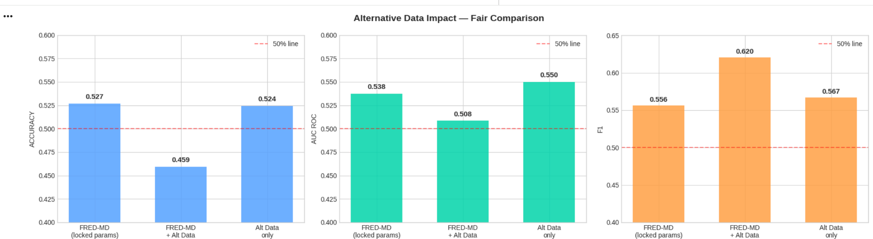
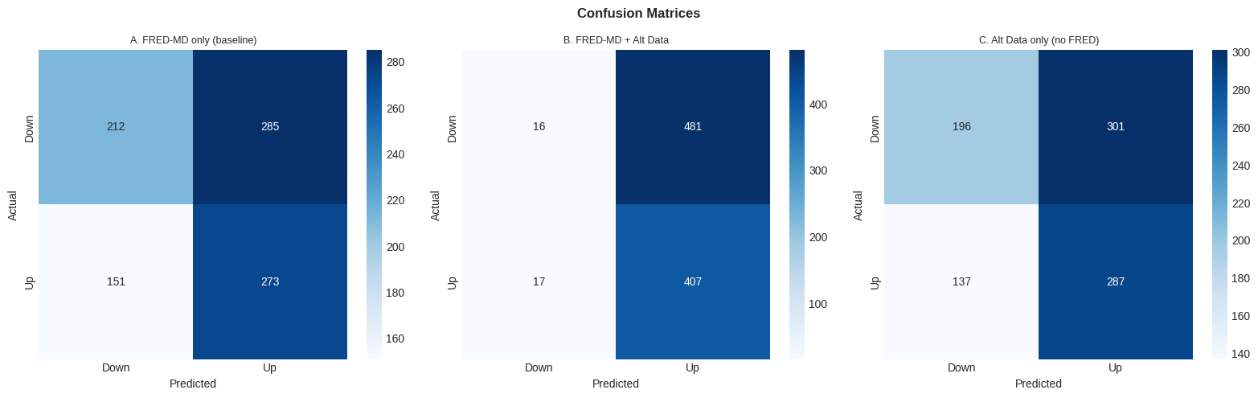
Week 1
NYU
Trial Implementation of the Plan
Colab Link
Notes:
SPEAKER NOTES — Slide 2: ARX ARX is the classical econometric baseline implemented in Week 1. It predicts tomorrow's wheat price using two components: its own past prices (the AR part, up to 3 lags) and 31 macroeconomic features from FRED-MD (the exogenous part). Fitting is done in closed form using Ridge OLS — no iterative training, no learning rate issues. Alpha=5 applies mild L2 regularisation to handle the multicollinearity across 31 correlated macro features. Grid search over ar_lags, exog_lags, and alpha found the best configuration is ar_lags=3, exog_lags=1, alpha=5. This tells us that only the most recent few days of price history matter, and only the current month's macro reading (not lagged) adds value. Test R²=0.983, essentially identical to the naive persistence baseline at 0.984. This is expected — wheat futures prices are highly autocorrelated day-to-day, and the AR-3 coefficient of 0.88 means the model is mostly saying "tomorrow ≈ today." The exogenous features add only marginal correction. The test plot (right) shows the model tracks the 2022 Ukraine war spike and the subsequent decline. The fit looks good visually, but the RMSE of 20.99 vs naive 20.37 tells us the linear model is not adding value over simple persistence. This sets the baseline. Any neural model that can't beat ARX isn't worth deploying.

